Slide 1
Chapter 1. Find roots of an equation

Slide 2
Numerical errors
Propagated vs. computational error
x = exact value, y = approx. value
F = exact function, G = its approximation
G(y) – F(x) = [G(y) - F(y)] + [F(y) - F(x)]
Rounding vs. truncation error
Rounding error: introduced by finite precision calculations in the computer arithmetic
Truncation error: introduced by algorithm via problem simplification, e.g. series truncation, iterative process truncation etc.
Total error =
Computational error:
affected by algorithm
Propagated data error:
not affected by algorithm
+
Computational error = Truncation error + rounding error

Slide 3
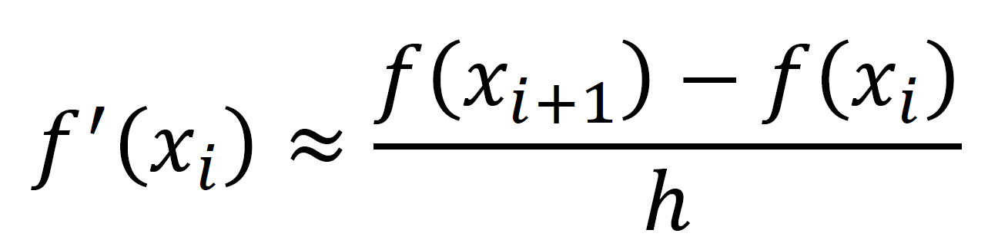
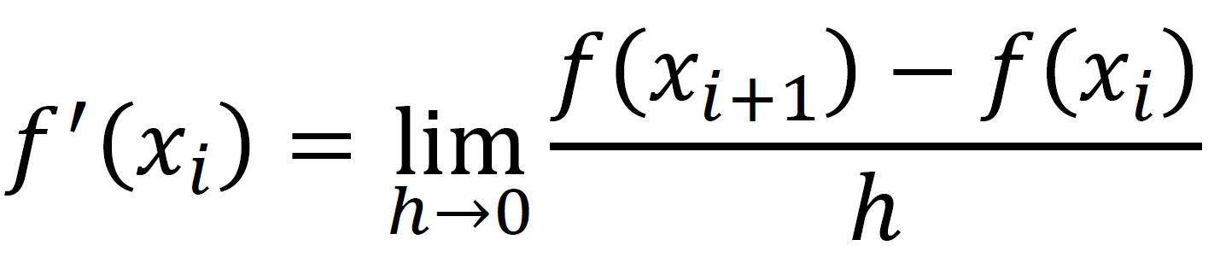
Truncation errors
Truncation errors are problem specific
Often, every step involves an approximation, e.g. a finite Taylor series
The truncation errors accumulate
Often, truncation errors can be calculated
Example 1
Example 2
Finite difference approximation for computing derivative

Slide 4
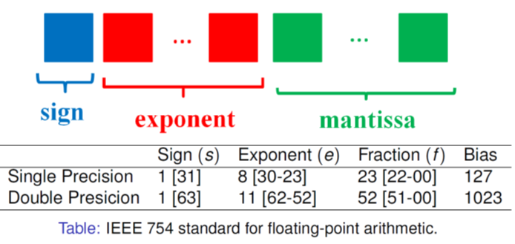
Roundoff errors
Precision of representation of numbers is finite
The Limits of Single-precision Floating-Point Numbers

Slide 5
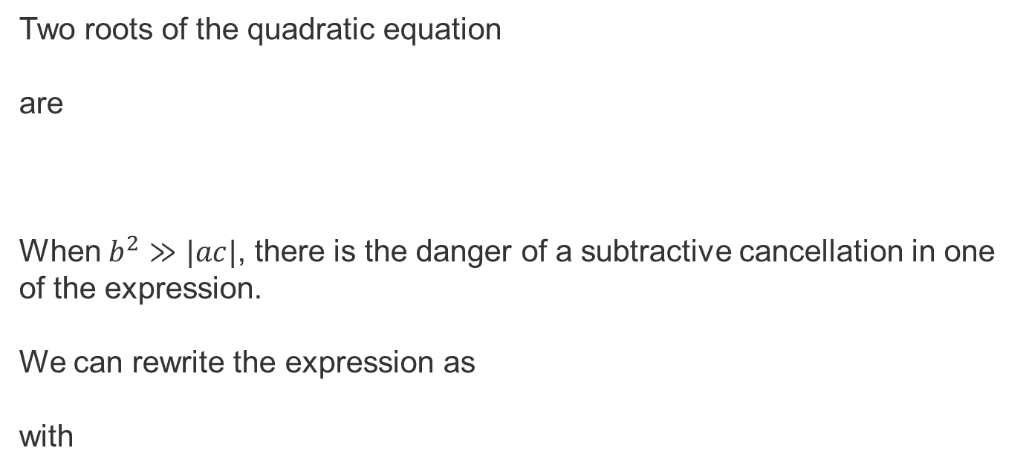
Example of roundoff errors
Two roots of the quadratic equation
are
When $b^{2}≫|ac|$, there is the danger of a subtractive cancellation in one of the expression.
We can rewrite the expression as
with
e.g., 0.001x²+1000x+0.001=0

Slide 6
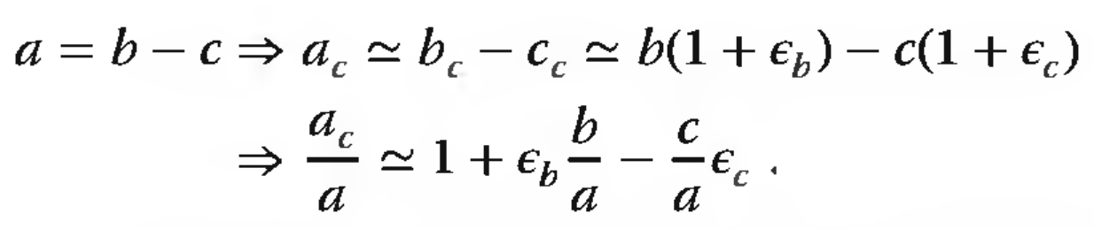
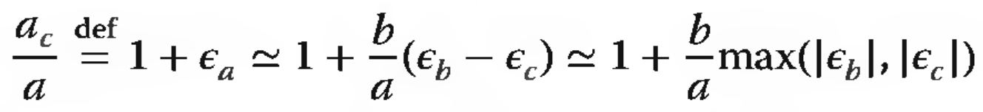
数值计算应注意的问题
1.避免相近二数相减，避免大数和小数相加
两个相近数的前几位有效数字是相同的，相减后有效数字位会大大减少。例如，√1001≈31.64， √1000≈31.62，求（√1001-√1000)的值，直接相减结果为0.02（0.01580），只有一位有效数字，计算中损失了3位有效数字。
c: 计算机里的表示
ε: 相对误差

Slide 7
∫dx sinx/x
2.避免小分母溢出
3.避免大数溢出
4.乘法快于除法： *0.5 v.s. /2.0
b=2.0*pi
do i=1,10000
a=a+b
end do
do i=1,10000
a=a+2.0*pi
end do
v.s.
5. 最底层循环尽量优化：

Slide 8
Roots of an equation
In physics, we often encounter situations in which we need to find the possible value of x that ensures the equation f(x)=0, where f(x) can either be an explicit or an implicit function of x. If such a value exists, we call it a root or zero of the equation.
If we need to find a root for f(x)=a, then how?
define g(x)=f(x)-a, and find a root for g(x)=0.

Slide 9
Bisection method
If we know that there is a root x_{r} in the region [a,b] for f(x)=0, we can use the bisection method to find it within a required accuracy.
Most intuitive method.
f (a) f (b) < 0
b=x₀
a = x₀
x₀ = (a + b)/2
f (a) f (x₀) < 0
f (x₀) f (b) < 0
f (a) f (x₀) < 0 or
f (x₀) f (b) < 0?
no
| f (x₀)|<δ?
yes
output!

Slide 10
c = (a + b)/2

Slide 11
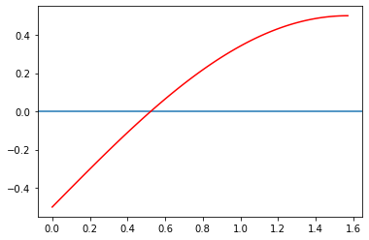
Code Example
f(x)=sin(x)-0.5; x is within 0 to π/2.
Analytically, we know the root is π/6.
Numerically, the procedure is:
since [sin(0)-0.5]*[sin(π/2)-0.5]<0 and [sin(0)-0.5]*[sin(π/4)-0.5]<0, but [sin(π/2)-0.5]*[sin(π/4)-0.5]>0;
then the root must be within (0,π/4).
Then we calculate the value at π/8.
......
Bisection.cpp

Slide 12
Bracket finding Strategies
Graph the function
May require 1000’s of points and thus function calls to determine visually where the function crosses the x-axis
“Exhaustive searching” – a global bracket finder
Looks for changes in the sign of f(x)
Need small steps so that no roots are missed
Need still to take large enough steps that this doesn’t take forever

Slide 13
Error Analysis and Convergence Criterion
 absolute value of the difference (ε_{d})
 relative percent error (ε_{r})
 true error (ε_{t}) in the ith iteration

Slide 14
Convergence analysis of bisection method
At each iteration the interval [a_{i},b_{i}] is divided into halves
Rate of convergence is linear

Slide 15
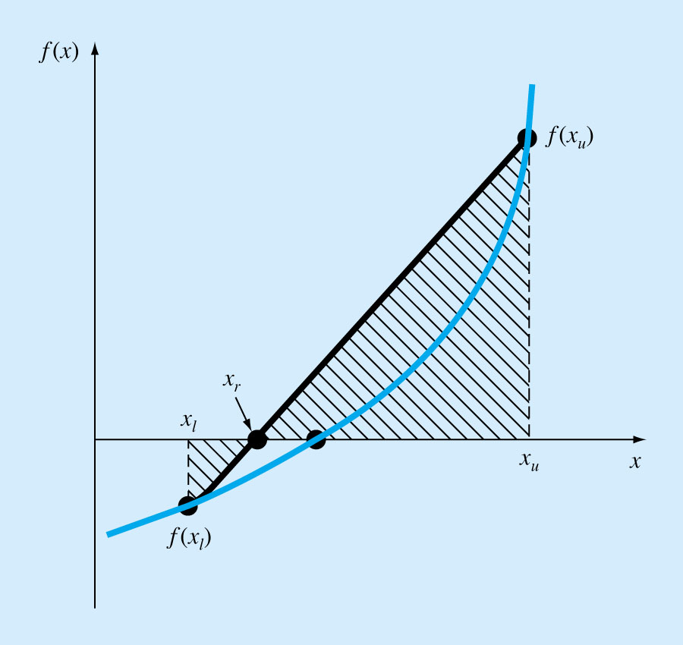
Regula-Falsi Method (False-Position)
We can approximate the solution by doing a linear interpolation between f(x_{u}) and f(x_{l})
Find x_{r} such that l(x_{r})=0, where l(x) is the linear approximation of f(x) between x_{l} and x_{u}
Derive x_{r} using similar triangles

Slide 16
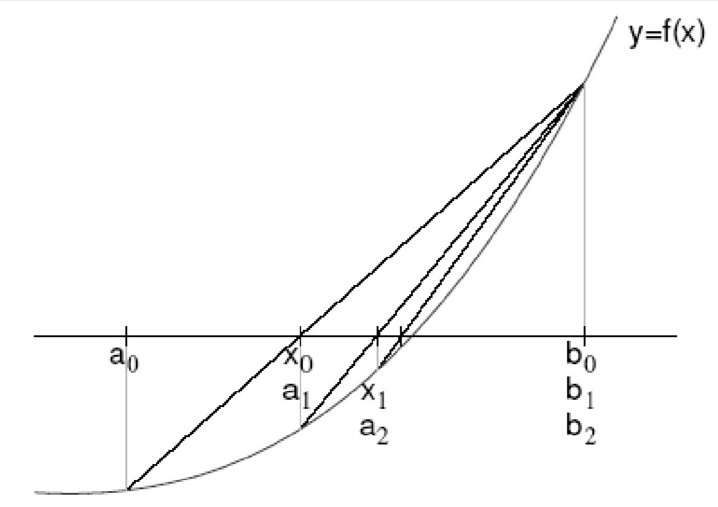
Iterations in Regula-Falsi Method

Slide 17
The Newton method
i.e., Newton-Raphson
Based on Taylor expansion
Where:
R_{n} is the remainder term to account for all terms from n+1 to infinity.
And
is a value of x that lies somewhere between x_{i} and x_{i+1}

Slide 18
The Newton method
i.e., Newton-Raphson
This method is based on linear approximation of a smooth function around its root. We can formally expand the function f (x_{r}) = 0 in the neighborhood of the root x_{r} through the Taylor expansion.
where x can be viewed as a trial value for the root of x_{i} at the ith step and the approximate value of the next step x_{i+1} can be derived.

Slide 19
(i = 0, 1, . . . .)

Slide 20
Code example
Example:
f(x)=sin(x)-0.5; f’(x)=cos(x)
i | x_{i} | f_{i} | f_{i}'
0 | 0 | -0.5 | 1
1 | 0.5 | …… | ……
NewtonRoot.cpp

Slide 21
Newton Method – Convergence
Exact root
Mean Value theorem
truncates Taylor series
But
by Newton
definition

Slide 22
Newton Method – Convergence
Subtracting
Dividing through
Convergence is quadratic

Slide 23
Newton Method – Convergence
Local Convergence Theorem
If
Then Newton’s method converges given a sufficiently close initial guess (and convergence is quadratic)

Slide 24
Newton Method – Convergence
Example 1
Convergence is quadratic

Slide 25
Newton Method – Convergence
Example 2
Note : not bounded
away from zero
Convergence is linear

Slide 26
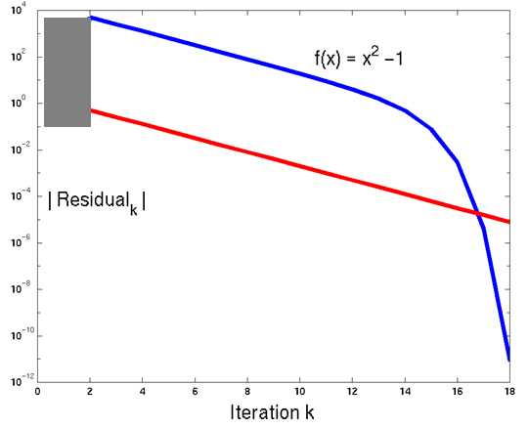
Newton Method – Convergence
Example 1,2

Slide 27
Possible failure
If the function is not monotonous
If f'_{i}=0 or very small at some points
Works well when the function is monotonous, especially with moderate f'.

Slide 28
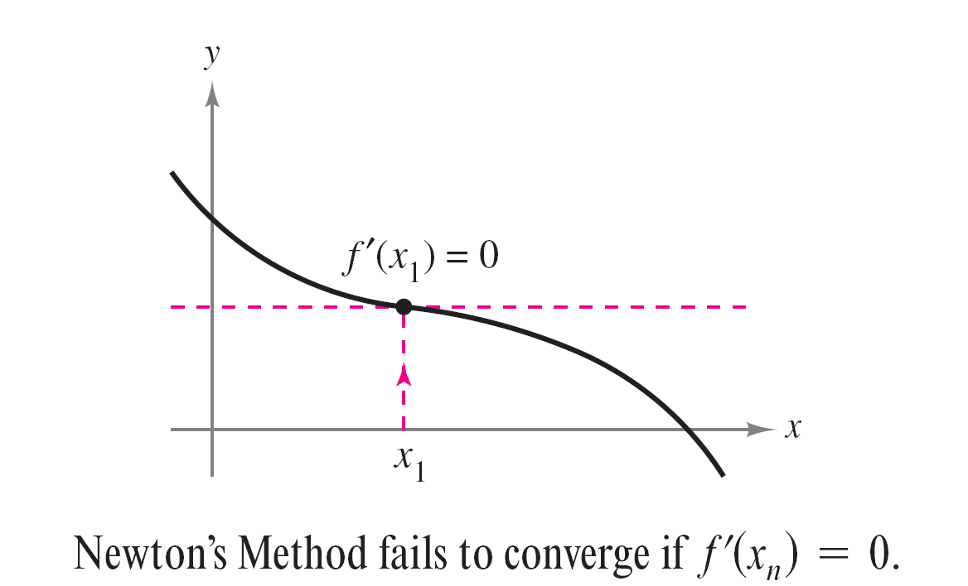
Nonconvergence Cases
Case 1: If the initial estimate is selected such that the derivative of the function equals zero.
An example case of f ’(x_{i}) = 0 :
Way to solve this:
choosing a different value for x₁

Slide 29
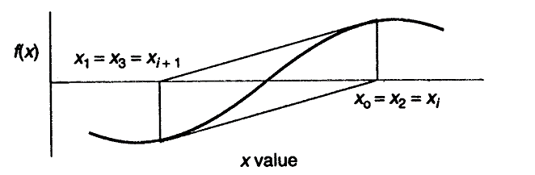
Case 2:

Slide 30
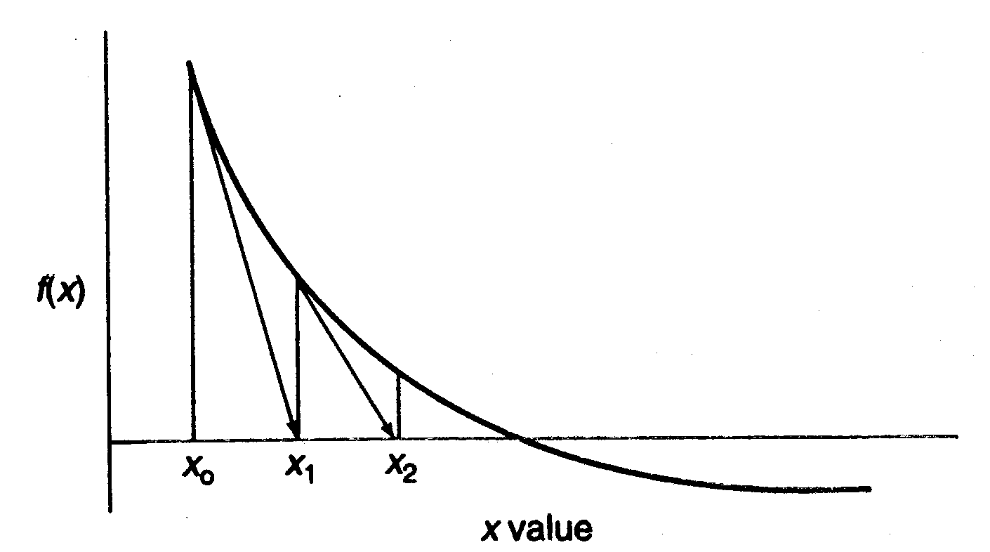
Case 3: A large number of iterations will be required if f’(x_{i}) is much larger than f(x_{i}). In such cases, is small, which leads to a small adjustment at each iteration.

Slide 31

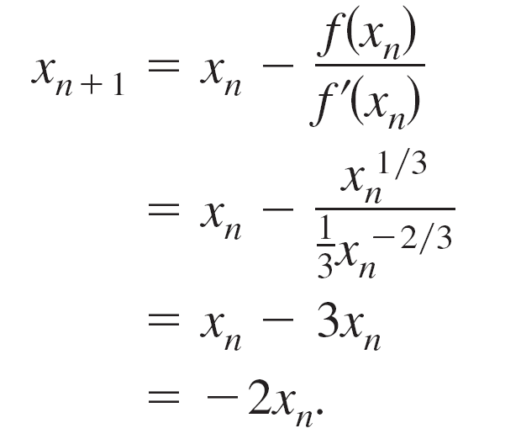
Case 4: function f(x) is not differentiable at the root.
The function f(x) = x^{1/3} is not differentiable at x = 0. Show that Newton’s Method fails to converge using x₁ = 0.1.

Slide 32
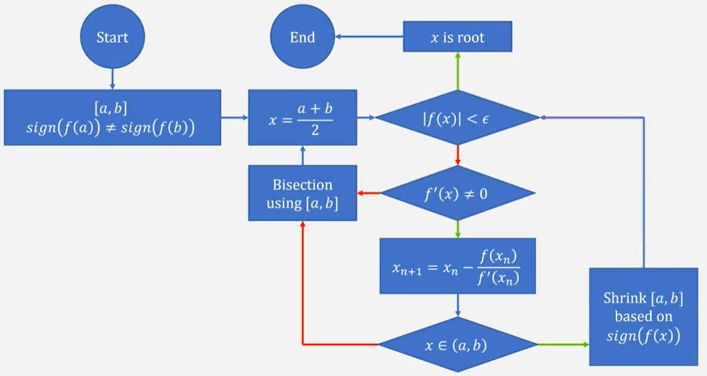
Newton Bisection Hybrid (Newt-Safe)
Yes
No
No
Yes
No
Yes
Example: rtsafe.f from the famous Numerical Recipes

Slide 33
Secant method - discrete Newton method
In many cases, especially when f (x) has an implicit dependence on x, an analytic expression for the first-order derivative needed in the Newton method may not exist or may be very difficult to obtain.
We have to find an alternative scheme to achieve a similar algorithm. One way to do this is to replace the analytic f'(x) with the two-point formula for the first-order derivative, which gives

Slide 34
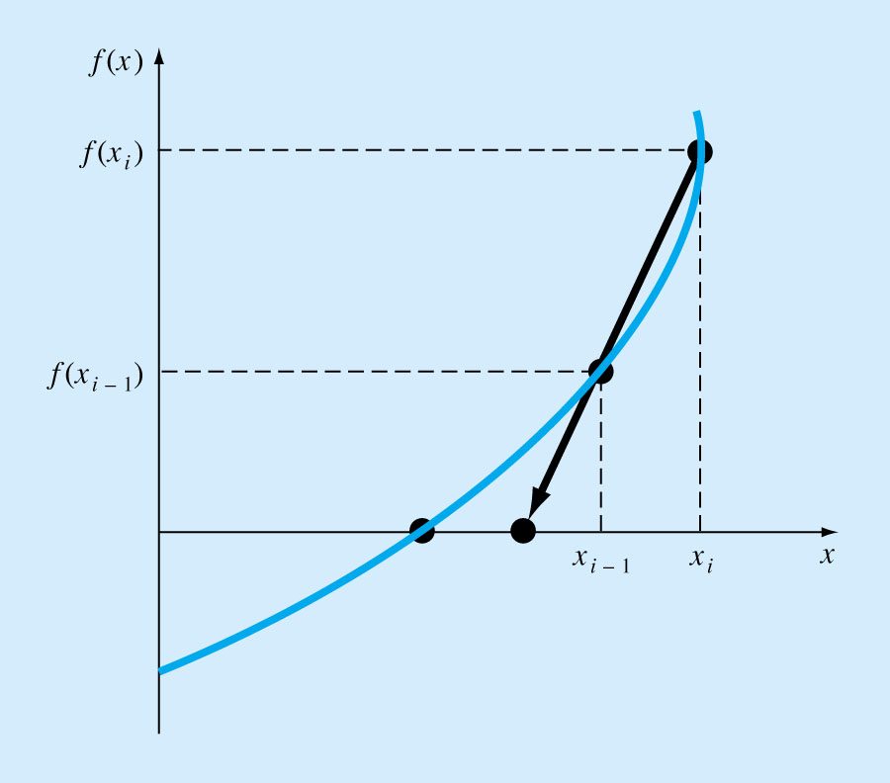
The Secant Method
Requires two initial estimates x_{o}, x₁.
However, it is not a “bracketing” method.
The Secant Method has the same properties as Newton’s method.
Convergence is not guaranteed for all x_{o}, f(x).

Slide 35
Code example
Example:
g(x)=sin(x)-0.5
i | x_{i} | f_{i}
0 | 0 | -0.5
1 | π/2 | 0.5
2 | π/4 | ……
Secant.cpp

Slide 36
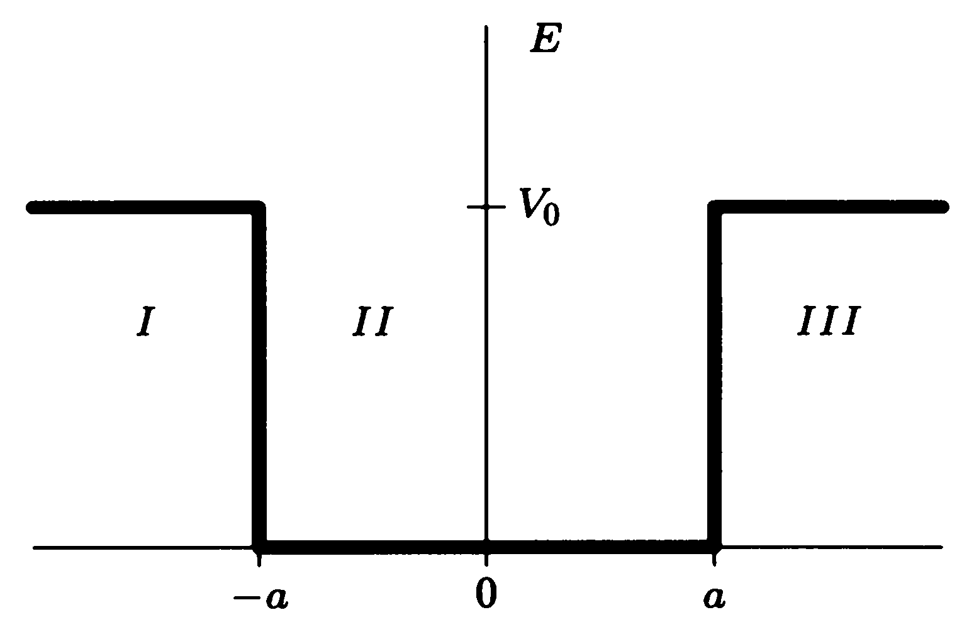
Physics problem: Finite Square-Well Potential
The finite square-well potential is:
Schrödinger Equation
The solution outside the finite well in regions I and III, where E < V₀, is:
the wave function must be zero at x = ±∞.

Slide 37
Now, the boundary conditions require that:
Two kinds of solutions (different parity, see group theory):
Even states:
Odd states:

Slide 38
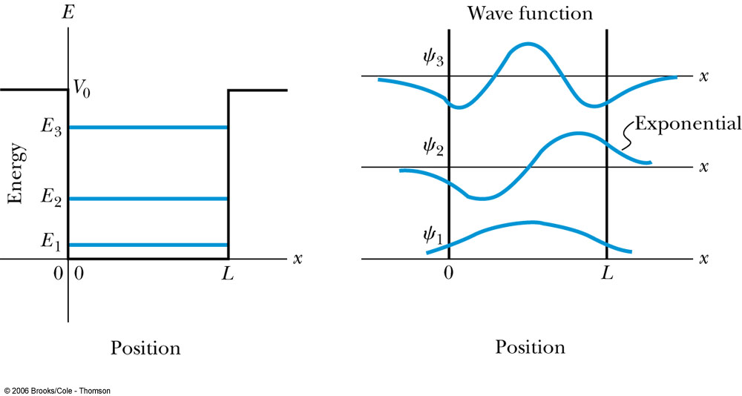
Our target: determine A,B,C,F and energy E
e.g., for even states, solve
Use hybrid method to find E

Slide 39
Roots of an equation
Extremes of a function

Slide 40
Extremes of a function
An associated problem to find the root of an equation is finding the maxima and/or minima of a function.
Examples of such situations in physics occur when considering the equilibrium position of an object, the potential surface of a field, and the optimized structures of molecules and small clusters.

Slide 41
We know that an extreme of g(x) occurs at the point with
which is a minimum (maximum) if f'(x) = g''(x) is greater (less) than zero. So all the root-search schemes discussed so far can be generalized here to search for the extremes of a single-variable function.

Slide 42
Example
The (ionic) bond length of the diatomic molecule
Na
Cl
where e is the charge of a proton, ε₀ is the electric permittivity of vacuum, and V₀ and r₀ are parameters of this effective interaction.
The first term comes from the Coulomb interaction between the two ions, but the second term is the result of the electron distribution in the system.

Slide 43
The force:
At equilibrium, the force between the two ions is zero. Therefore, we search for the root of
f(x) = -dV(x)/dx = 0.

Slide 44
code example
parameters for NaCl
e²/4πε₀ = 14.4 AeV
V₀ = 1.09 x 10³ eV
r₀ = 0.33 A
r starts from 1 A
3.6.NaCl.cpp

Slide 45
Steepest-descent method
In principle, the search process should be forced to move along the direction of descending the function g(x) when looking for a minimum. In other words, for x_{i+1}=x_{i}+Δx_{i}, the increment Δx_{i} has the sign opposite to g'(x_{i}).
Thus, an update scheme can be formulated:
with 'a' being a positive, small, and adjustable parameter. For the minimum, f' (or g'') must be positive.

Slide 46
This scheme can be generalized to the multivariable case as
where x = (x₁ , x ₂ , . . . , x _{l} ) and
∇g(x) = (∂g/∂x₁ , ∂g/∂x ₂ , . . . , ∂g/∂x_{l} ).
Note that step Δx_{i} here is scaled by |∇g(x_{i})| and is forced to move toward the direction of the steepest descent. This is why this method is known as the steepest-descent method.
Widely used in machine learning!

Slide 47
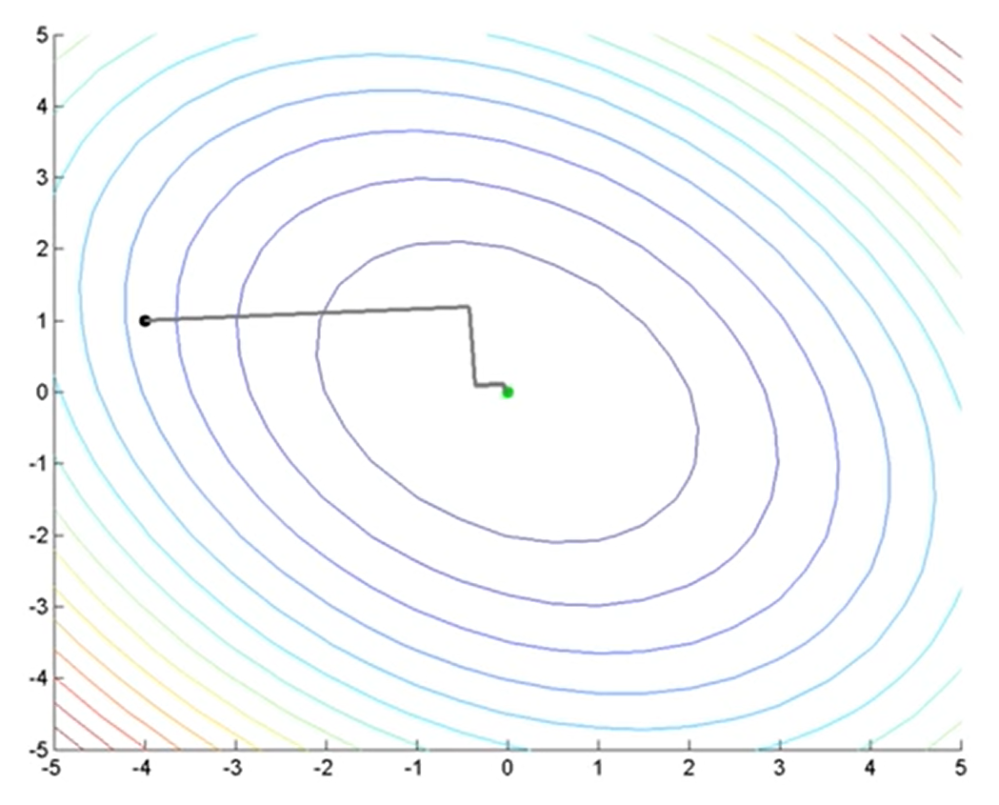
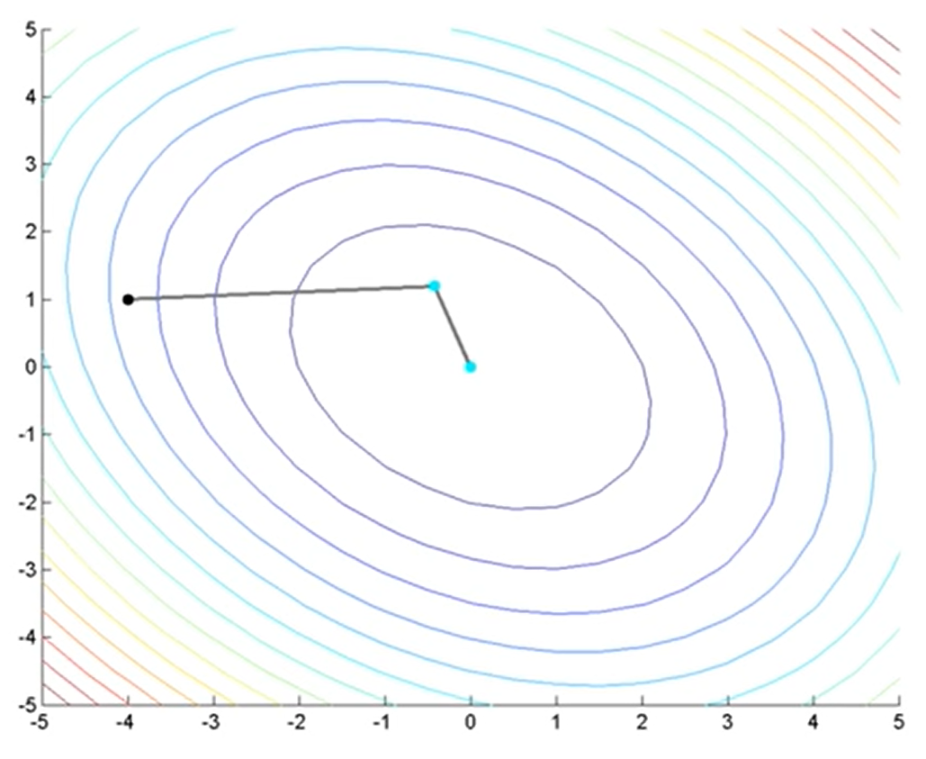
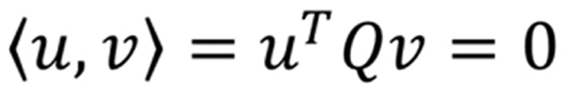
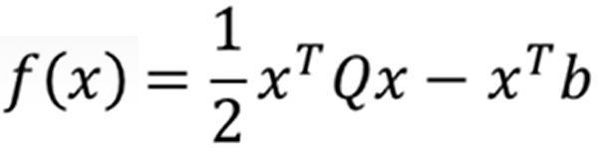
Conjugate gradient method
See Numerical Recipes Sec. 10.6
Gradient-descent method: may need many steps to reach the minimum
Search directions are orthogonal to each other
Conjugate gradient method: fast convergence (maybe n step for n-dim)
Search directions are conjugate to each other

Slide 48
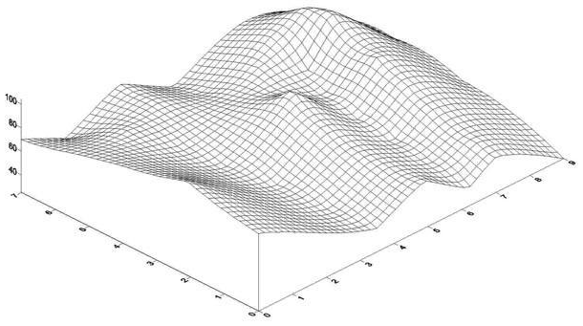
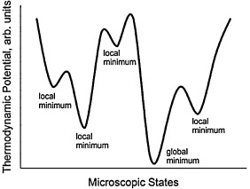
Other methods for finding minima of a function
Local minima: quasi-Newton method etc
Global minima: Simulated annealing, Genetic algorithm, Particle swarm optimization, Differential evolution etc
(Derivative-free Optimization)

Slide 49
Homework
1. Sketch the function x³ − 5x + 3 = 0.
(i) Determine the two positive roots to 4 decimal places using the bisection method. Note: You first need to bracket each of the roots.
(ii) Take the two roots that you found in the previous question (accurate to 4 decimal places) and “polish them up” to 14 decimal places using the Newton-Raphson method.
(iii) Determine the two positive roots to 14 decimal places using the hybrid method.
2. Search for the minimum of the function
g(x,y)=sin(x+y)+cos(x+2*y)
in the whole space.

Slide 50
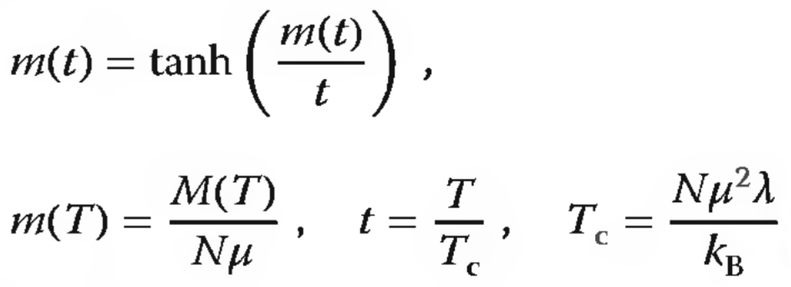
3. Temperature dependence of magnetization
Determine M(T) the magnetization as a function of temperature T for simple magnetic materials. (see https://en.wikipedia.org/wiki/Curie%27s_law)
m: reduced magnetization
t: reduced temperature
For a given t, solve m, plot m as a function of t

